Slide 1
MATLAB for image processing Session 1: Introduction

Slide 2
Course structure
Session 1
Introduction to MATLAB
Data types
Conditional statements and loops
Session 3
Advanced data structures
Advanced image reading (Bioformats)
Object-oriented programming
Session 2
Matrix operations
Image processing
Session 4
Figures and plotting
Designing a user interface

Slide 3

Under construction!
Comments/requests?
Let me know!
stephen.cross@bristol.ac.uk

Slide 4
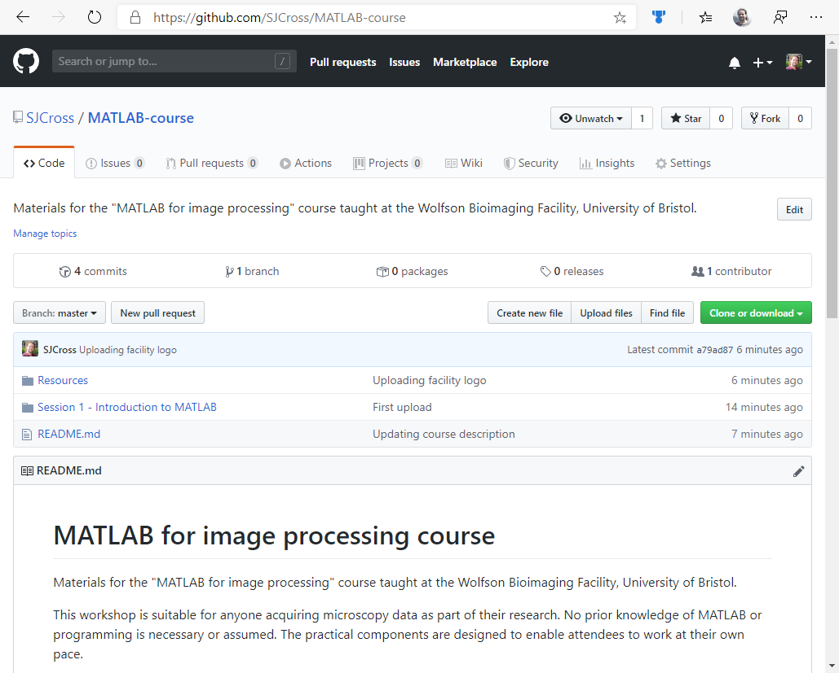
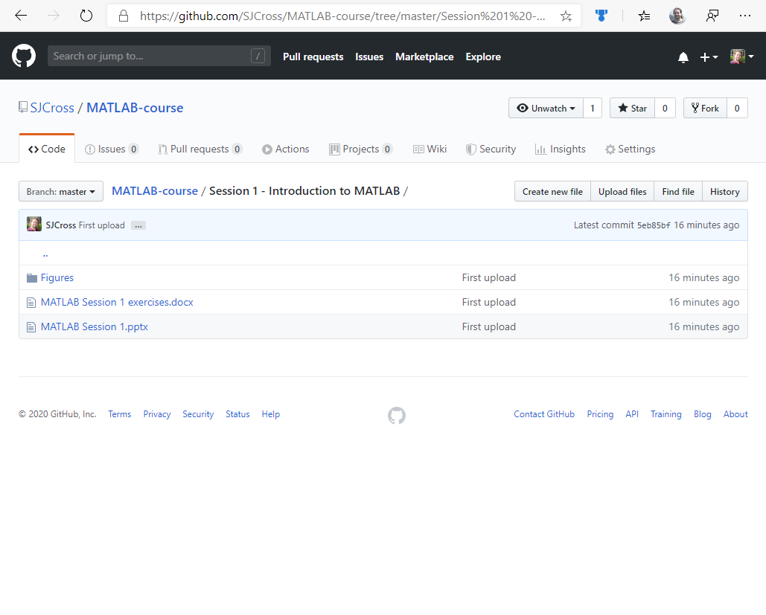
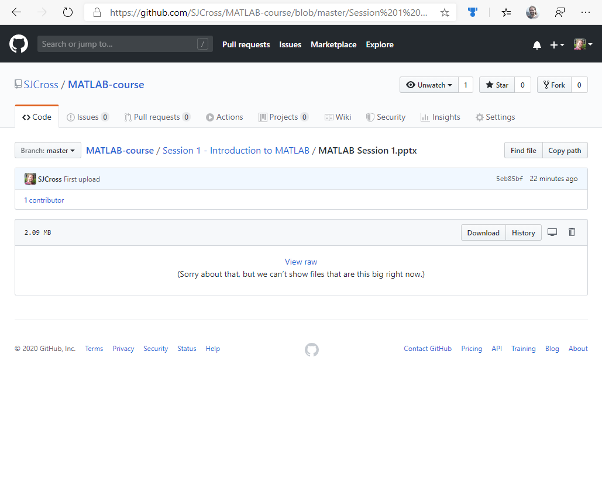
Accessing course materials
https://github.com/SJCross/MATLAB-course

Slide 5
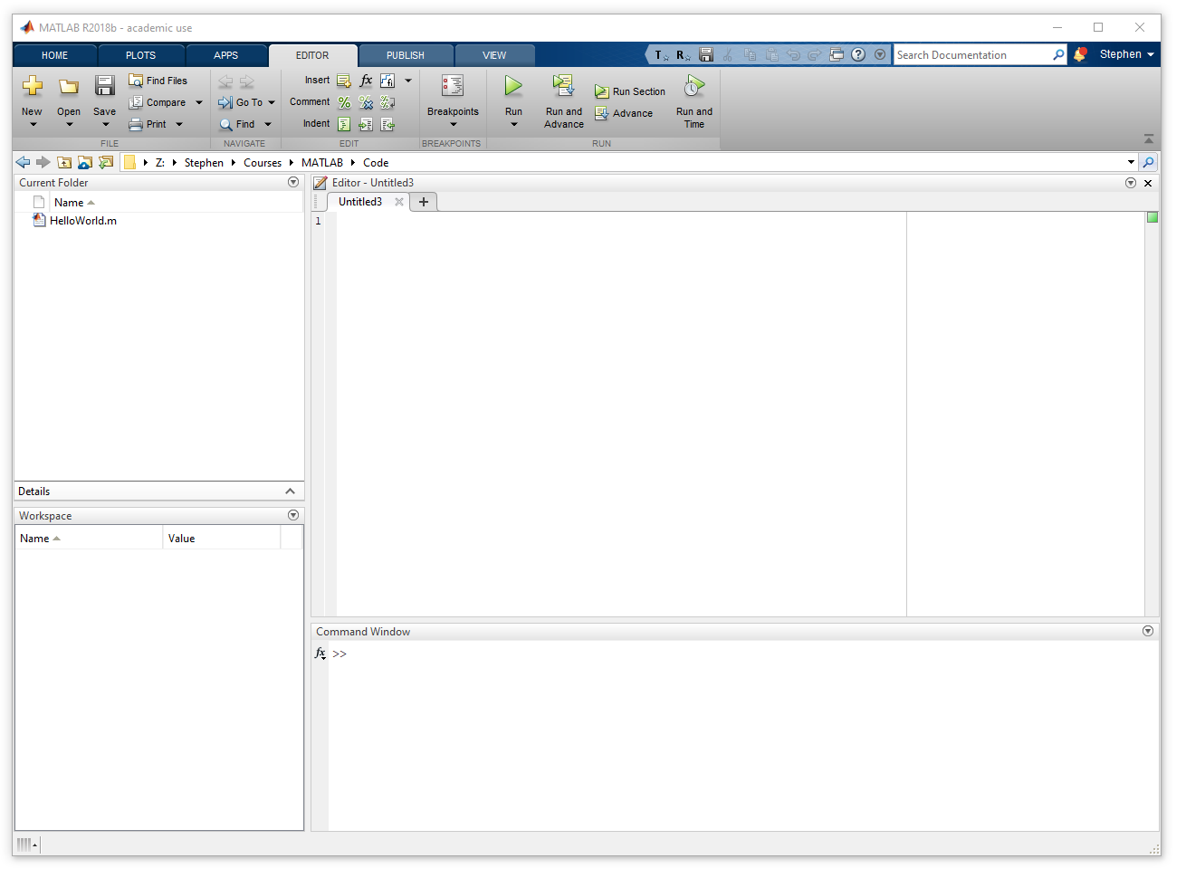
Before we go any further
Open a copy of MATLAB
(It should look something like this)

Slide 6
Introduction to MATLAB
Notes:
Convert this into 2 spider diagrams if there’s time

Slide 7
What is MATLAB?
The language
Scripting
Matrix manipulation
Proprietary & closed source
The software
Integrated development environment
Apps for software development
Code must be run from within MATLAB
Notes:
Convert this into 2 spider diagrams if there’s time

Slide 8
What is MATLAB?
Navigation bar
Current folder
Text editor
Workspace
Command window
Notes:
Convert this into 2 spider diagrams if there’s time

Slide 9
Running code in MATLAB
Running it live
Type directly into the command window
MATLAB interprets and runs the code immediately
The >> symbol means MATLAB is ready to roll
Notes:
Live demo of typing in the command line, then running a pre-prepared script

Slide 10
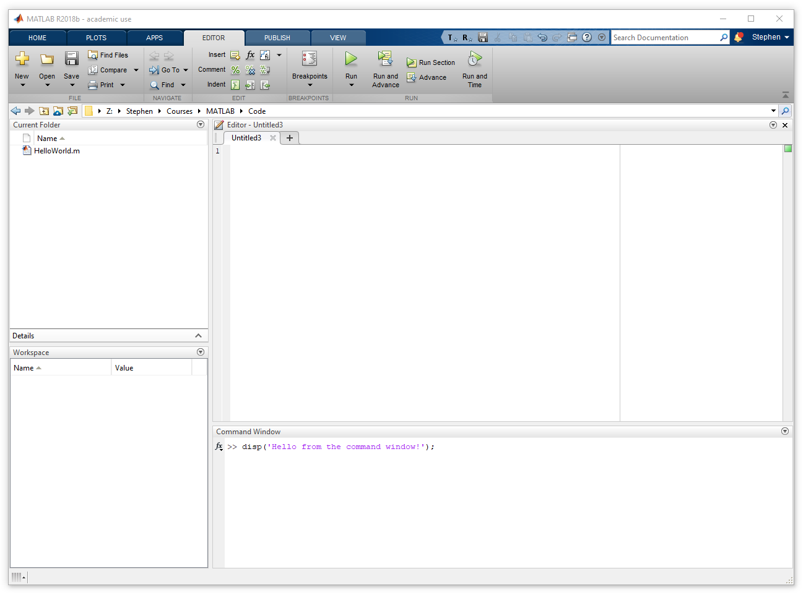
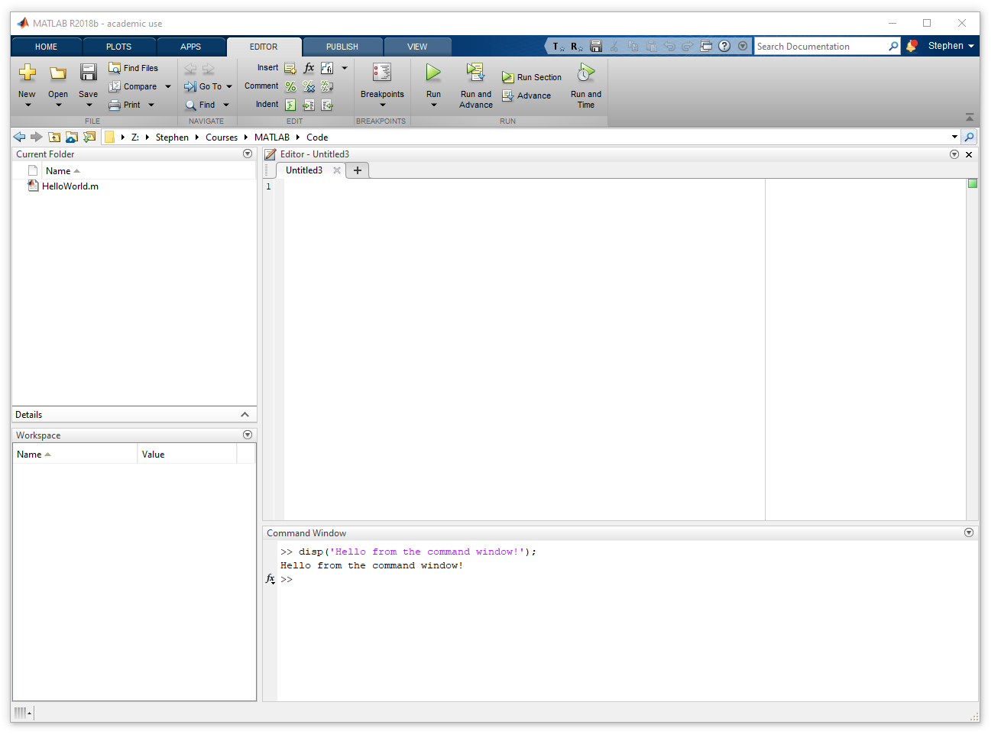
Running code in MATLAB
Running it live
Type directly into the command window
MATLAB interprets and runs the code immediately
The >> symbol means MATLAB is ready to roll
Notes:
Live demo of typing in the command line, then running a pre-prepared script

Slide 11
Running code in MATLAB
Running it live
Type directly into the command window
MATLAB interprets and runs the code immediately
The >> symbol means MATLAB is ready to roll
Exercise: Run some code in the command window
Type the following into the command window, then press “Enter”.
disp('Hello from the command window!');
Notes:
Live demo of typing in the command line, then running a pre-prepared script

Slide 12
Running code in MATLAB
Running it live
Type directly into the command window
MATLAB interprets and runs the code immediately
The >> symbol means MATLAB is ready to roll
Exercise: Run some code in the command window
The message “Hello from the command window!”
should appear on the next line
Notes:
Live demo of typing in the command line, then running a pre-prepared script

Slide 13
Running code in MATLAB
Pre-prepared scripts
M-files are plain text files with a “.m” extension that contain MATLAB code
MATLAB provides an editor to make these (or you can use any text editor)
To run, type the name of the script in the command window
File must be in active directory or on MATLAB path
Notes:
Live demo of typing in the command line, then running a pre-prepared script

Slide 14
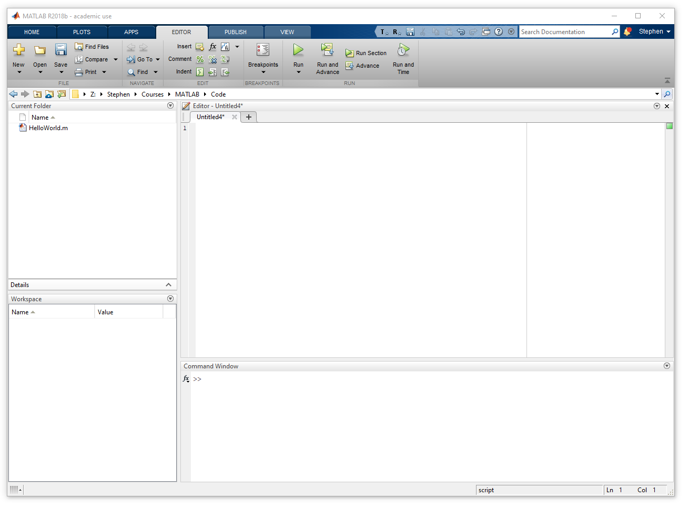
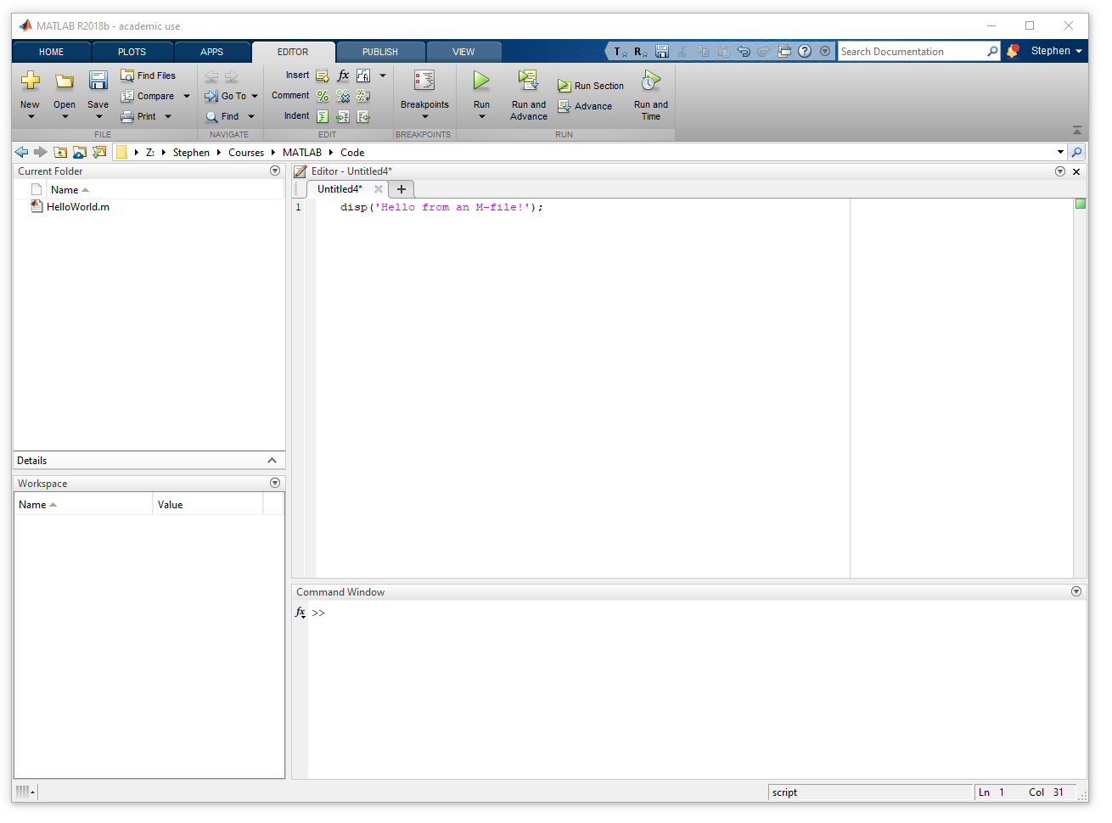
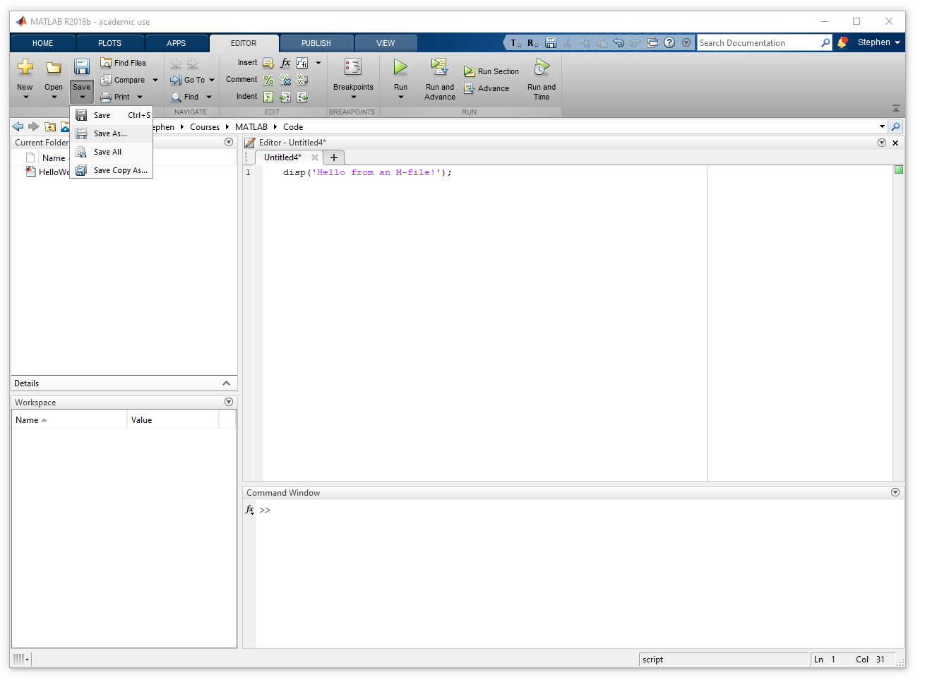
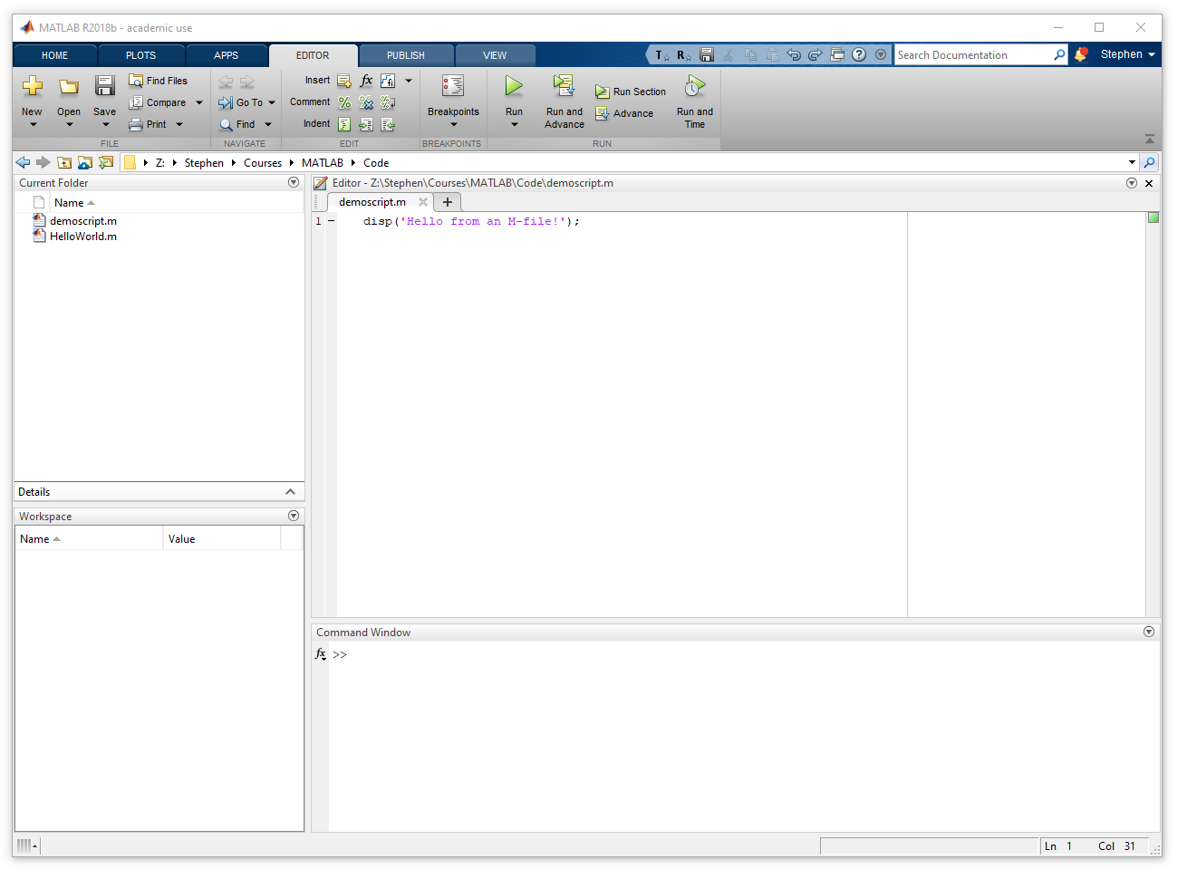
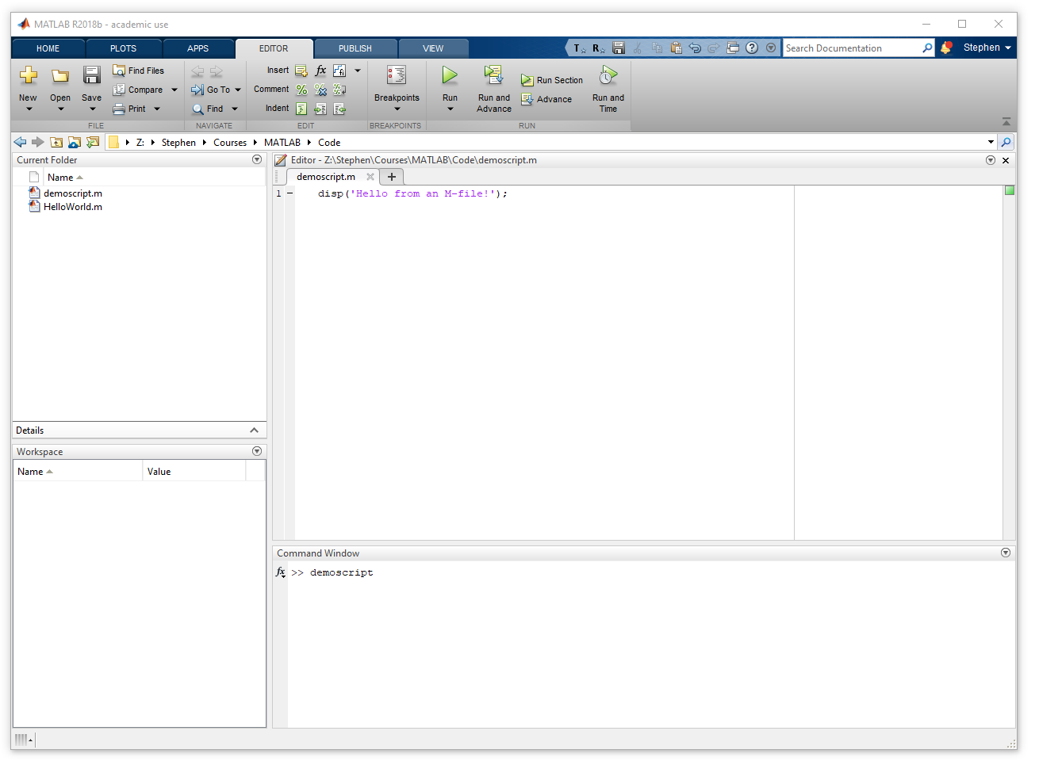
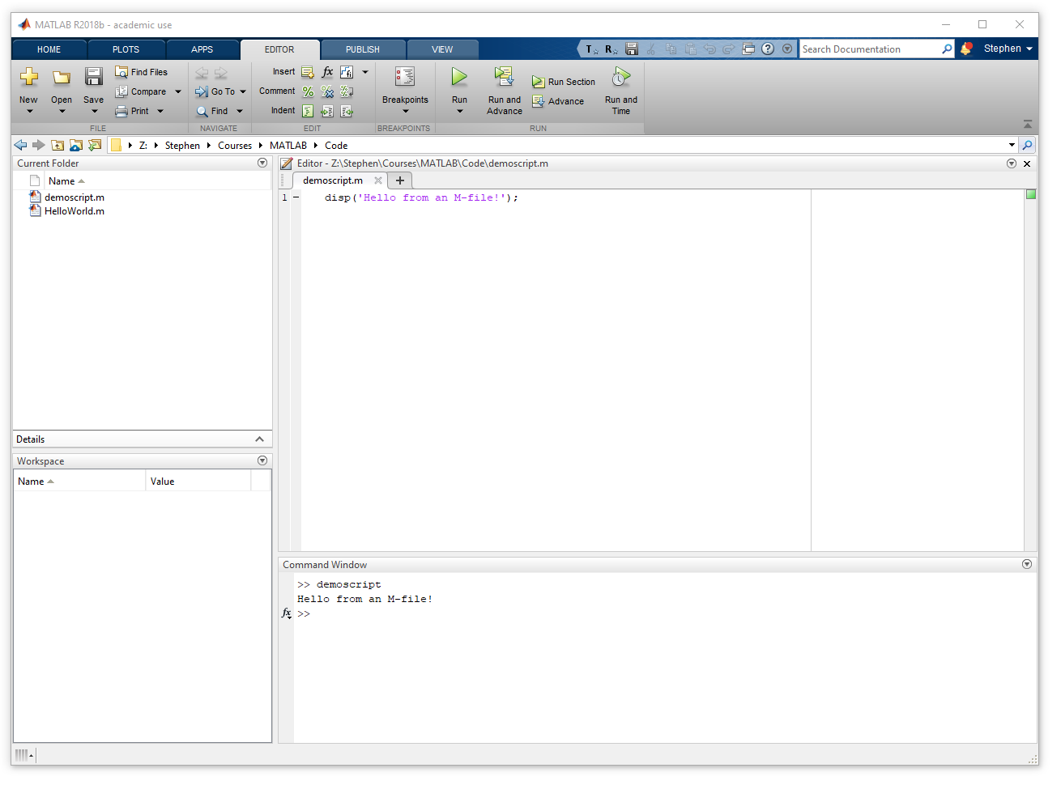
Running code in MATLAB
Pre-prepared scripts
M-files are plain text files with a “.m” extension that contain MATLAB code
MATLAB provides an editor to make these (or you can use any text editor)
To run, type the name of the script in the command window
File must be in active directory or on MATLAB path
Notes:
Live demo of typing in the command line, then running a pre-prepared script

Slide 15
Running code in MATLAB
Pre-prepared scripts
M-files are plain text files with a “.m” extension that contain MATLAB code
MATLAB provides an editor to make these (or you can use any text editor)
To run, type the name of the script in the command window
File must be in active directory or on MATLAB path
Exercise: Create and run an M-file
In the editor, create a new script file and add the following code
disp('Hello from an M-file!');
From the “Editor” tab, save the script to a file called demoscript.m
In the command window, type demoscript and press “Enter”
Notes:
Live demo of typing in the command line, then running a pre-prepared script

Slide 16
Running code in MATLAB
Pre-prepared scripts
M-files are plain text files with a “.m” extension that contain MATLAB code
MATLAB provides an editor to make these (or you can use any text editor)
To run, type the name of the script in the command window
File must be in active directory or on MATLAB path
Exercise: Create and run an M-file
Did the code run?
If not, it’s likely because MATLAB didn’t know where to look
for the demoscript.m file
Notes:
Live demo of typing in the command line, then running a pre-prepared script

Slide 17
The “active directory” and “path”
MATLAB looks for code in two places
M-files must be in one of these to run from the command window
The active directory
Contents visible in “current folder”
To see active directory, type pwd
Set from the navigation bar
The MATLAB path
A list of folders that MATLAB searches
To see the path, type path
To add folders to the path, use the Set Path tool
Notes:
Live demo of typing in the command line, then running a pre-prepared script

Slide 18
The “active directory” and “path”
MATLAB looks for code in two places
M-files must be in one of these to run from the command window
The active directory
Contents visible in “current folder”
To see active directory, type pwd
Set from the navigation bar
The MATLAB path
A list of folders that MATLAB searches
To see the path, type path
To add folders to the path, use the Set Path tool
Notes:
Live demo of typing in the command line, then running a pre-prepared script

Slide 19
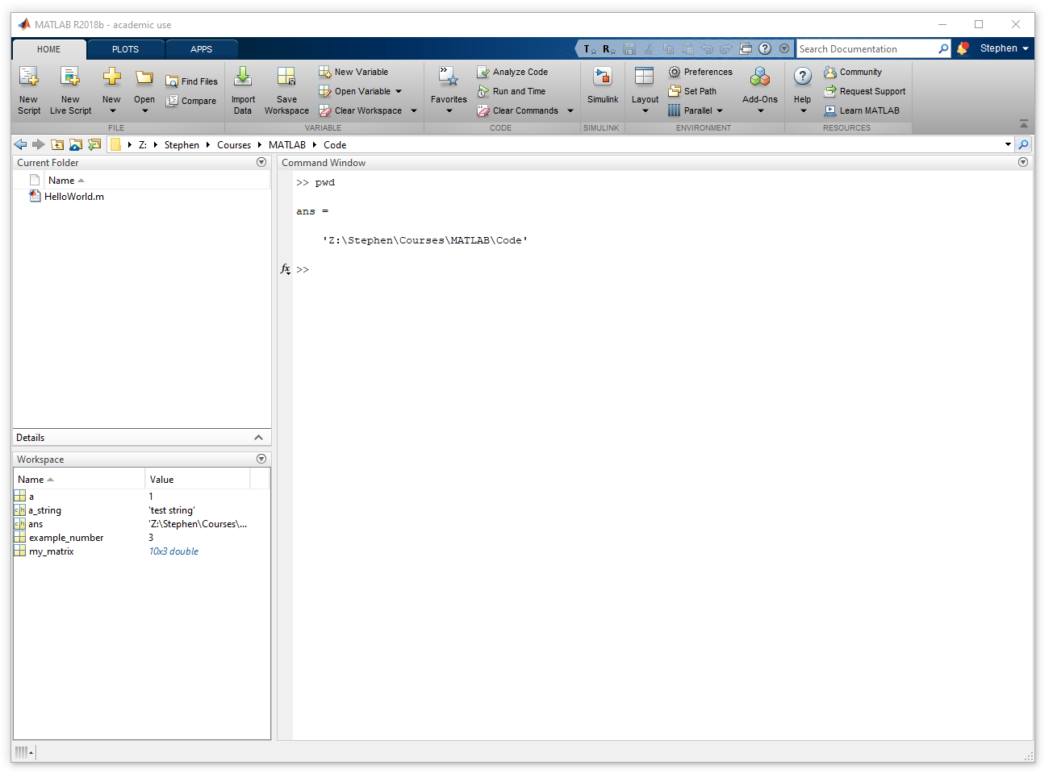
The “active directory” and “path”
MATLAB looks for code in two places
M-files must be in one of these to run from the command window
The active directory
Contents visible in “current folder”
To see active directory, type pwd
Set from the navigation bar
The MATLAB path
A list of folders that MATLAB searches
To see the path, type path
To add folders to the path, use the Set Path tool
Notes:
Live demo of typing in the command line, then running a pre-prepared script

Slide 20
The “active directory” and “path”
MATLAB looks for code in two places
M-files must be in one of these to run from the command window
The active directory
Contents visible in “current folder”
To see active directory, type pwd
Set from the navigation bar
The MATLAB path
A list of folders that MATLAB searches
To see the path, type path
To add folders to the path, use the Set Path tool
Notes:
Live demo of typing in the command line, then running a pre-prepared script

Slide 21
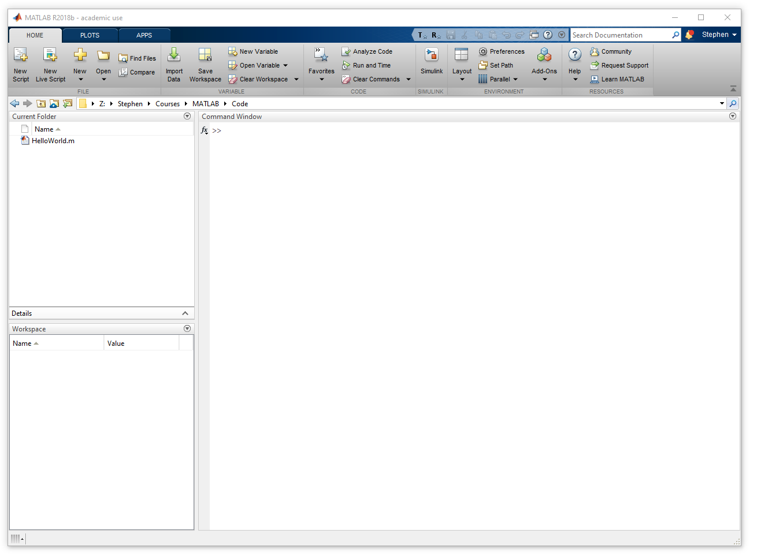
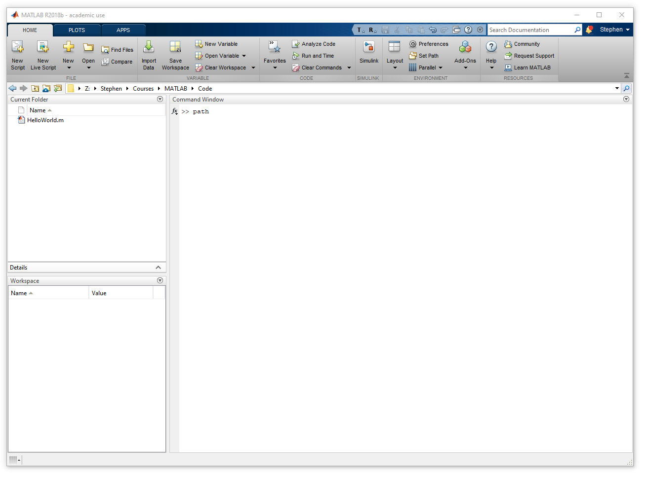
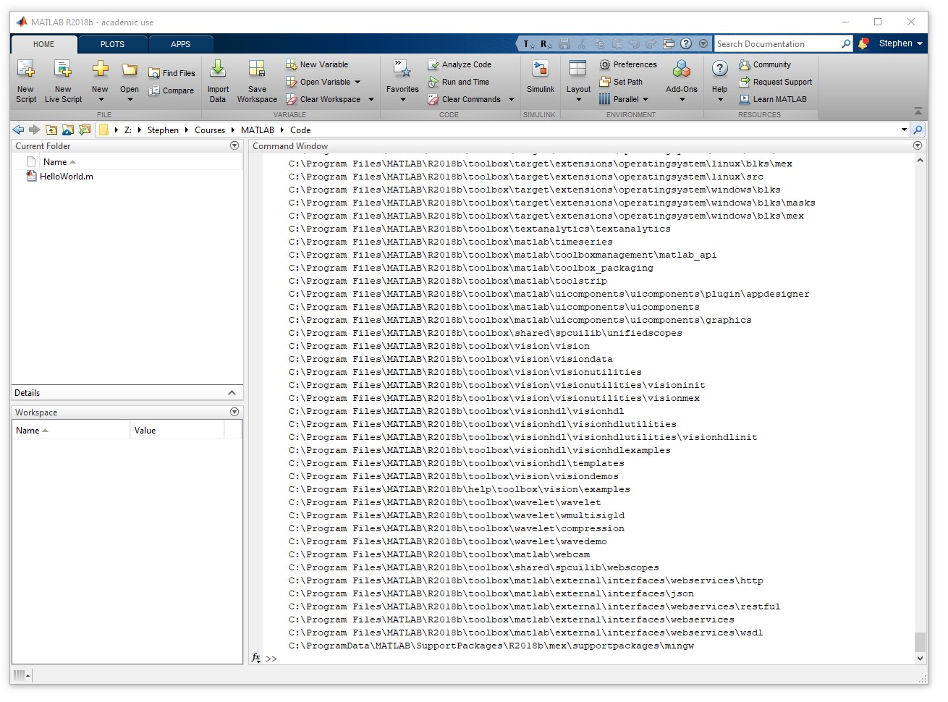
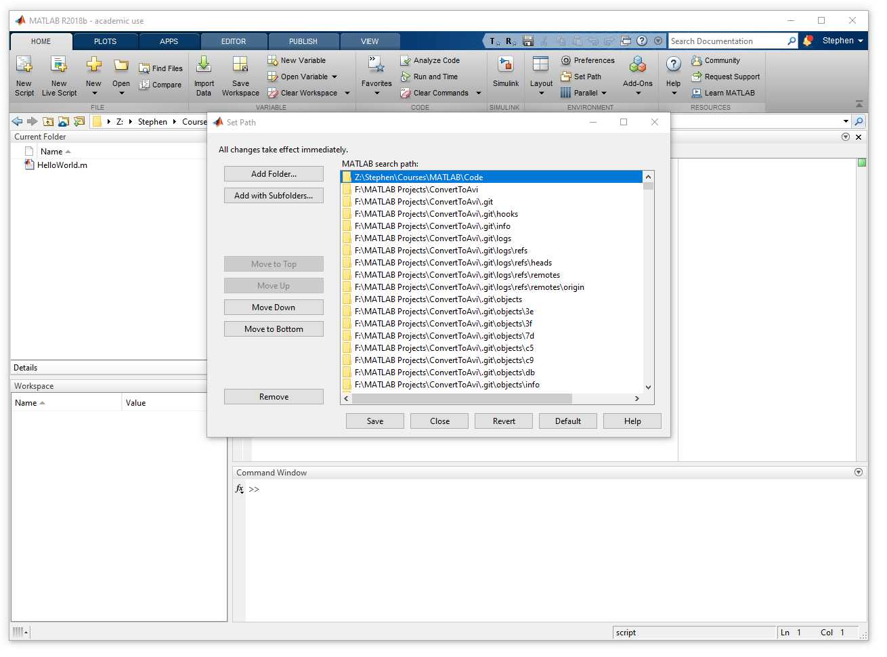
The “active directory” and “path”
MATLAB looks for code in two places
M-files must be in one of these to run from the command window
The active directory
Contents visible in “current folder”
To see active directory, type pwd
Set from the navigation bar
The MATLAB path
A list of folders that MATLAB searches
To see the path, type path
Add To add folders to the path, use the Set Path tool
Notes:
Live demo of typing in the command line, then running a pre-prepared script

Slide 22
Variables
Notes:
Convert this into 2 spider diagrams if there’s time

Slide 23
Variables
Values stored in the workspace (i.e. in MATLAB’s memory)
We can access that value using a specific reference
Workspace panel shows a summary of that value
We can call the reference nearly anything
Must start with a letter and contain no whitespace
e.g. my_variable_name or another_variable_3
Assign variables using =
e.g. number_to_store = 3.14
e.g. loaded_image = imread('Z:\Stephen\Courses\MATLAB\ExampleImage.tif');

Slide 24
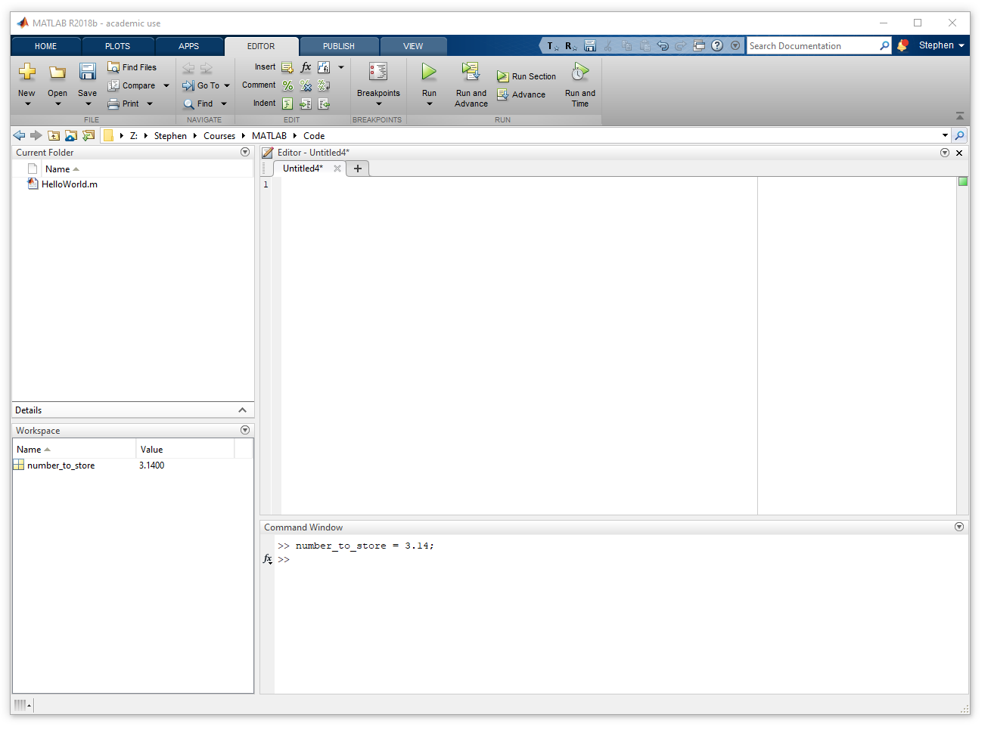
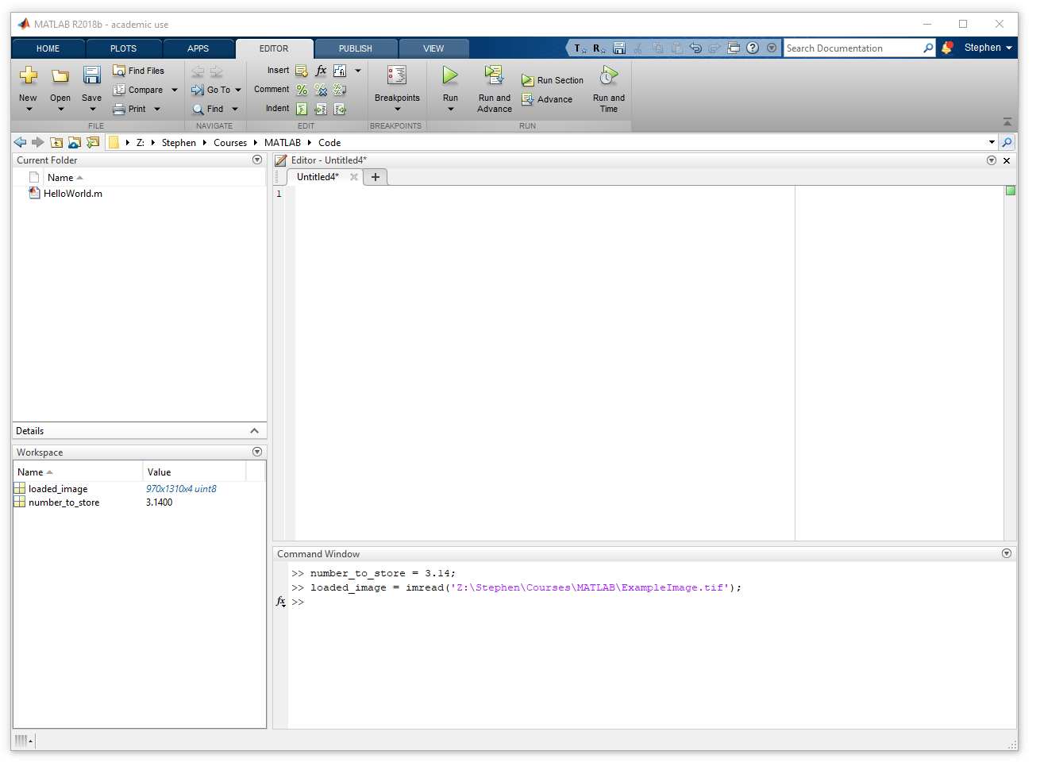
Variables
Values stored in the workspace (i.e. in MATLAB’s memory)
We can access that value using a specific reference
We can call the reference nearly anything
Must start with a letter
No whitespace
e.g. my_variable_name or another_variable_3
Assign variables using “=“
e.g. number_to_store = 3.14
e.g. loaded_image = imread(‘Z:\Stephen\Courses\MATLAB\ExampleImage.tif’);

Slide 25
Variables
Remove all variables from workspace using clear
You should include this as the first line of a script
Clear specific variables by using their name
e.g. To remove a variable called “var_1”, use clear var_1
The most recent non-assigned output is stored in ans
Handy if you forgot to assign a reference to a variable!

Slide 26
Why use variables?
Why not type the values explicitly?
Can’t we just write the values straight into the code?
Values unknown when writing the code
If all values were known at the beginning, the output would always be the same
e.g. An image loaded by the user must be stored in the workspace
A reference lets us access this
Repeated use of a value
e.g. A spatial calibration (distance/pixel), which is used many times

Slide 27
Functions
Notes:
Convert this into 2 spider diagrams if there’s time

Slide 28
Functions
Pre-prepared segments of code
Accessible using their name
A single function typically does one job
Example functions
Display a message: disp('Hello from the command window!');
Load an image: output_image = imread('Z:\Stephen\MATLAB\ExImage.tif');
Get image dimensions: image_size = size(output_image);
Save an Excel file: xlswrite('Z:\Stephen\MATLAB\MyResults.xlsx', results_table);
These are all defined with a common form

Slide 29
Using functions
[val_1, val_2] = myexamplefunction(arg_1, arg_2, arg_3)
Function name
Must be typed exactly
Arguments
Inputs for the function
There can be any number of arguments separated by commas
Returned values
Specified in square brackets and comma separated

Slide 30
Using functions
[val_1, val_2] = myexamplefunction(arg_1, arg_2, arg_3)
Function name
Must be typed exactly
Arguments
Inputs for the function
There can be any number of arguments separated by commas
Returned values
Specified in square brackets and comma separated

Slide 31
Using functions
[val_1, val_2] = myexamplefunction(arg_1, arg_2, arg_3)
Function name
Must be typed exactly
Arguments
Inputs for the function
There can be any number of arguments separated by commas
Returned values
Specified in square brackets and comma separated

Slide 32
Using functions
[val_1, val_2] = myexamplefunction(arg_1, arg_2, arg_3)
Function name
Must be typed exactly
Arguments
Inputs for the function
There can be any number of arguments separated by commas
Returned values
Specified in square brackets and comma separated

Slide 33
Using functions
[val_1, val_2] = myexamplefunction(arg_1, arg_2, arg_3)
Let’s look at those example functions again
Display a message: disp('Hello from the command window! ');
Load an image: output_image = imread('Z:\Stephen\MATLAB\ExImage.tif');
Get image dimensions: image_size = size(output_image);
Save an Excel file: xlswrite('Z:\Stephen\MATLAB\MyResults.xlsx', results_table);

Slide 34
Creating functions
One function per file
First line should declare the function form
Variables are specific to that function
Variables declared inside a function can’t be used elsewhere
This includes between iterations of the same function

Slide 35
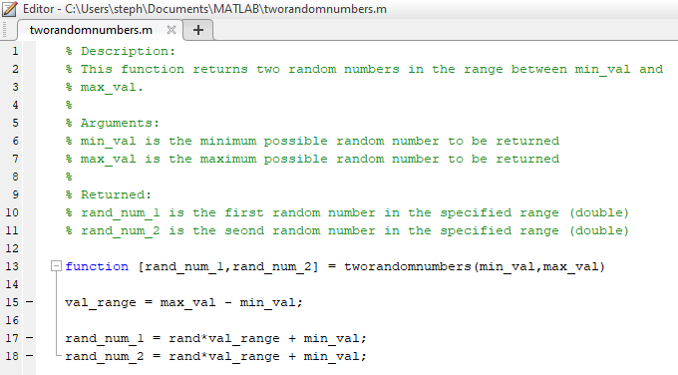
Creating functions
An example function file
Creates two random numbers in a specified range

Slide 36
Documenting code
Code should be well documented
You’ll be thankful you did in 18 months!
…and so will your collaborators/successors
Adding comments to code
Any line starting with % will be ignored by MATLAB
Comments will automatically appear in green
What to include
What the code is doing
Focus on tricky bits of code, where the intention isn’t obvious
Notes:
First, give example of typing code live

Slide 37
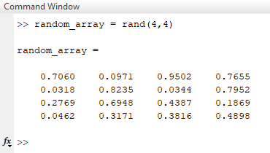
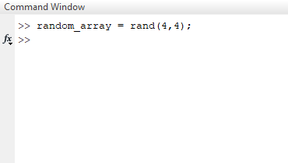
And Another Thing…
By default, MATLAB will display a text output after each command
Including a semicolon at the end of the line suppresses this output
Unlike other languages (including ImageJ macro), MATLAB doesn’t need a semicolon at the end of the line
Notes:
Live demo of typing in the command line, then running a pre-prepared script

Slide 38


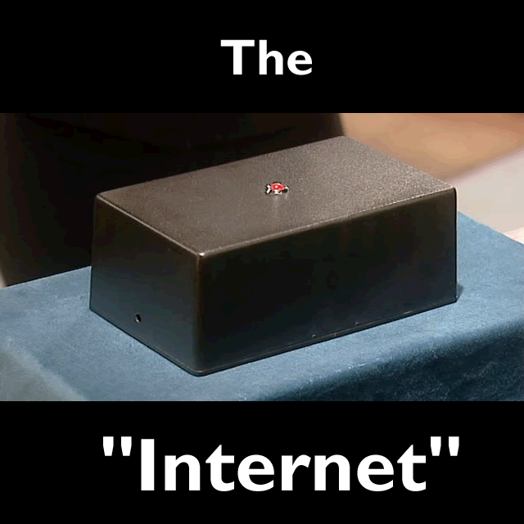




Where to get help
Notes:
Say we will re

Slide 39
Where to get help
MATLAB Central (https://uk.mathworks.com/matlabcentral/)
Large online community
First, search to see if your question has already been answered
Documentation
Just type doc followed by the function name (e.g. doc imread)
Error messages
These state the error in relatively plain English
Wolfson Bioimaging Facility!
wolfson-analysis@bristol.ac.uk
Notes:
Say we will re

Slide 40
Data types
Notes:
Convert this into 2 spider diagrams if there’s time

Slide 41
Basic data types
Logical
Only values of 1 (true) or 0 (false)
Numeric
Integers: 0, 1, 2, 3, etc.
Floating point: 3.145
Text
Character arrays: ‘Hello World!’
String arrays: “Hello World!”
We will cover more over the next couple of sessions
Notes:
Say we will re

Slide 42
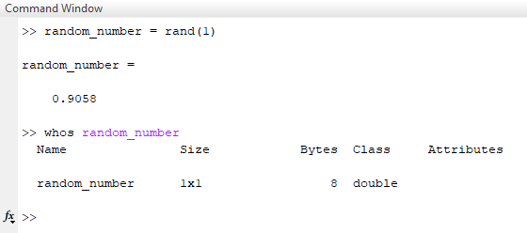
Basic data types
All data stored as sequences of 0s and 1s
A single 0 or 1 is called a “bit”
A sequence of eight 0s and 1s is called a “byte”
MATLAB often chooses what it considers the most appropriate type
See the data type for a variable using the whos function
This value uses 8 bytes (i.e. 64 0s or 1s), so is 64-bit
Notes:
Say we will re

Slide 43
Logical datatype
A value which is either true or false
Can be represented as 1 (true) or 0 (false)
Used in conditional statements and loops
We’ll look at these later in this session
Sometimes referred to as “Boolean” in literature
Example assignment
Using “true” and “false” keywords: my_logical_1 = true;
Using “logical” function: my_logical_2 = logical(1); (this will be true)
As a result of a conditional check: my_logical_3 = 4 > 8; (this will be false)
Notes:
Say we will re

Slide 44
Integer numeric type
Unsigned 8-bit integers
Number stored using 8 bits (0s and 1s)
Values in range 0 to 255
e.g. ex_value_1 = uint8(32);
Signed 8-bit integers
Number stored using 8 bits
256 possible combinations (2⁸ = 256)
Values in range -128 to 127
e.g. ex_value_2 = int8(-107);
Unsigned 8-bit
00000000 = 0
00000001 = 1
00000010 = 2
00000011 = 3
00000100 = 4
00000101 = 5
…
01111111 = 127
10000000 = 128
…
11111101 = 253
11111110 = 254
11111111 = 255
Notes:
Say we will re

Slide 45
Integer numeric type
Can use more bits if greater range is required
When dealing with images, you typically use uint8 or uint16
Full name | Short name | Number of bits | Value range
Signed 8-bit | int8 | 8 | -128 to 127
Unsigned 8-bit | uint8 | 8 | 0 to 255
Signed 16-bit | int16 | 16 | -32768 to 32767
Unsigned 16-bit | uint16 | 16 | 0 to 65535
Signed 32-bit | int32 | 32 | -2³¹ to 2³¹-1
Unsigned 32-bit | uint32 | 32 | 0 to 2³²-1
Signed 64-bit | int64 | 64 | -2⁶³ to 2⁶³-1
Unsigned 64-bit | uint64 | 64 | 0 to 2⁶⁴-1

Slide 46
Floating point numeric type
Stores numbers in “scientific notation” (e.g. -2.4 x10⁶)
As such, the decimal can “move” depending on the exponent
Single precision values (32-bit)
Values in range ~1.17 x10⁻³⁸ to ± ~3.40 x10³⁸
Numbers stored with 6-9 significant figures
Double precision values (64-bit)
Values in range ~2.23 x10⁻³⁰⁸ to ± ~1.80 x10³⁰⁸
Numbers stored with 15-17 significant figures
Default for numbers in MATLAB
Notes:
Say we will re

Slide 47
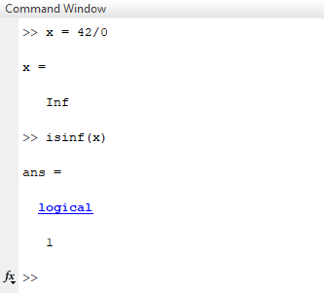
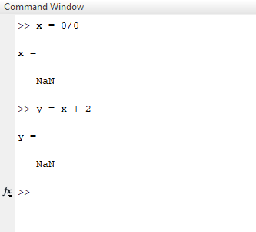
Special numbers
Inf (infinity)
Result of divide by zero operations
Use isinf to see if a value is infinity
NaN (not-a-number)
Result of special cases, 0/0 or Inf/Inf
Use isnan to see if a value is NaN
Operations using NaN will return NaN
Notes:
Say we will re

Slide 48
Numeric type summary
Choose the data type to fit the use
It can be a trade-off between speed, memory usage and precision
Are your values always going to be integers?
Will you ever get negative values?
Beware of rounding errors with floating point numbers
Numbers aren’t stored exactly (limited by significant figures)

Slide 49
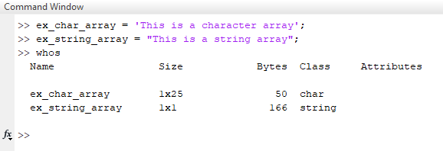
Text type
Text can be stored using two different data types
Both appear purple when typed in MATLAB editor
Character arrays
Specified using ‘ character
Use less memory
Are more common
String arrays (since MATLAB 2016b)
Specified using “ character
Are “objects” (see Session 3)
Have additional functionality (e.g. replace)
Notes:
Say we will re

Slide 50
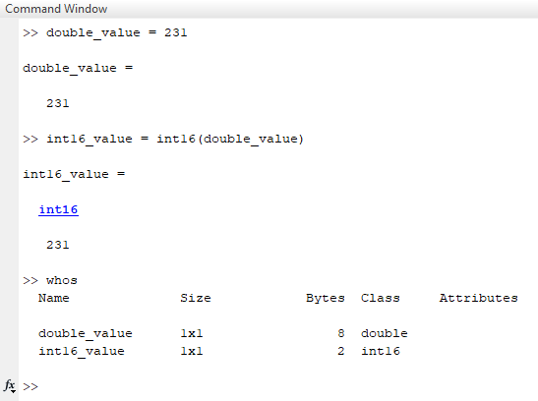
Converting between data types
Converting between numeric types
Use short name of target type before value
Full name | Short name
Signed 8-bit | int8
Unsigned 8-bit | uint8
Signed 16-bit | int16
Unsigned 16-bit | uint16
Signed 32-bit | int32
Unsigned 32-bit | uint32
Signed 64-bit | int64
Unsigned 64-bit | uint64
Single (float) | single
Double (float) | double
Notes:
Say we will re

Slide 51
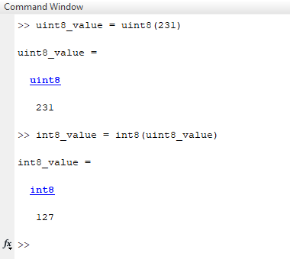
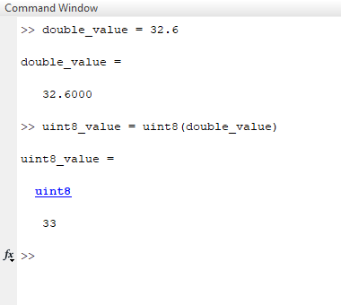
Converting between data types
Beware of available range
Is the value to convert beyond the range of the target type?
Beware of loss of precision
Are you converting a floating point value to an integer?
Notes:
Say we will re

Slide 52
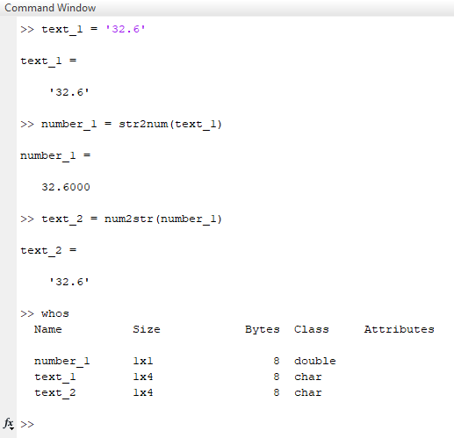
Converting between data types
Convert text to numbers using str2num
Can’t contain any non-numeric characters
Alternatively str2double
This can be applied on arrays
Convert numbers to text using num2str
Notes:
Say we will re

Slide 53
Conditional statements and loops
Notes:
Convert this into 2 spider diagrams if there’s time

Slide 54
Conditional statements
Controls whether a block of code executes
If condition not met, corresponding code is skipped
Structure of conditional statement
Statement always starts with if
A condition to test
The block of code to execute
Can be multiple lines
Statement ends with end
random_value = rand(1);
if random_value < 0.5
disp('Between 0 and 0.5');
end

Slide 55
Conditional statements
Controls whether a block of code executes
If condition not met, corresponding code is skipped
Structure of conditional statement
Statement always starts with if
A condition to test
The block of code to execute
Can be multiple lines
Statement ends with end
random_value = rand(1);
if random_value < 0.5
disp('Between 0 and 0.5');
end

Slide 56
Conditional statements
Controls whether a block of code executes
If condition not met, corresponding code is skipped
Structure of conditional statement
Statement always starts with if
A condition to test
The block of code to execute
Can be multiple lines
Statement ends with end
random_value = rand(1);
if random_value < 0.5
disp('Between 0 and 0.5');
end

Slide 57
Conditional statements
Controls whether a block of code executes
If condition not met, corresponding code is skipped
Structure of conditional statement
Statement always starts with if
A condition to test
The block of code to execute
Can be multiple lines
Statement ends with end
random_value = rand(1);
if random_value < 0.5
disp('Between 0 and 0.5');
end

Slide 58
Conditional statements
Controls whether a block of code executes
If condition not met, corresponding code is skipped
Structure of conditional statement
Statement always starts with if
A condition to test
The block of code to execute
Can be multiple lines
Statement ends with end
random_value = rand(1);
if random_value < 0.5
disp('Between 0 and 0.5');
end

Slide 59
Conditional statements
Executing alternative code if condition not met
Test another condition with elseif
Use else as a fallback
This will execute if all other conditions fail
random_value = rand(1);
if random_value < 0.5
disp('Between 0 and 0.5');
elseif random_value < 0.7
disp('Between 0.5 and 0.7');
else
disp('Between 0.7 and 1');
end

Slide 60
Conditional statements
Executing alternative code if condition not met
Test another condition with elseif
Use else as a fallback
This will execute if all other conditions fail
random_value = rand(1);
if random_value < 0.5
disp('Between 0 and 0.5');
elseif random_value < 0.7
disp('Between 0.5 and 0.7');
else
disp('Between 0.7 and 1');
end

Slide 61
Conditional statements
Executing alternative code if condition not met
Test another condition with elseif
Use else as a fallback
This will execute if all other conditions fail
random_value = rand(1);
if random_value < 0.5
disp('Between 0 and 0.5');
elseif random_value < 0.7
disp('Between 0.5 and 0.7');
else
disp('Between 0.7 and 1');
end

Slide 62
Conditional operators
Commonly used conditional operators
== | Equal to
~= | Not equal to
< | Less than
<= | Less than or equal to
> | Greater than
>= | Greater than or equal to
& | AND
| | OR
xor | XOR (one or the other, not both)
~ | NOT

Slide 63
While loops
A while loop is like a conditional statement that repeats until true
Similar syntax to conditional statement
Must start with while
Beware of loop getting stuck!
It must be possible for condition to change
random_value = rand(1);
while random_value < 0.5
disp('Between 0 and 0.5');
random_value = rand(1);
end
disp('Between 0.5 and 1');

Slide 64
Terminating MATLAB execution
Some times we need to stop MATLAB running
Maybe we’ve made a mistake and it gets stuck
Maybe it’s just taking too long
Terminate MATLAB using CTRL+C
Exercise: Break MATLAB!
Run the following (you may need to do it a couple of times)
random_value = rand(1);
while random_value < 0.5
disp('Between 0 and 0.5');
end
Terminate MATLAB’s execution using CTRL+C

Slide 65
For loops
Unlike while loops, for loops execute a fixed number of times
Structure of for loop
Loop always starts with for
A statement for number of iterations
Includes definition of iterator variable
MATLAB defines a range using : operator
The block of code to execute
Can be multiple lines
We can access iterator from here
Loop ends with end
for i = 1:10
disp(i);
end

Slide 66
For loops
Unlike while loops, for loops execute a fixed number of times
Structure of for loop
Loop always starts with for
A statement for number of iterations
Includes definition of iterator variable
MATLAB defines a range using : operator
The block of code to execute
Can be multiple lines
We can access iterator from here
Loop ends with end
for i = 1:10
disp(i);
end

Slide 67
For loops
Unlike while loops, for loops execute a fixed number of times
Structure of for loop
Loop always starts with for
A statement for number of iterations
Includes definition of iterator variable
MATLAB defines a range using : operator
The block of code to execute
Can be multiple lines
We can access iterator from here
Loop ends with end
for i = 1:10
disp(i);
end

Slide 68
For loops
Unlike while loops, for loops execute a fixed number of times
Structure of for loop
Loop always starts with for
A statement for number of iterations
Includes definition of iterator variable
MATLAB defines a range using : operator
The block of code to execute
Can be multiple lines
We can access iterator from here
Loop ends with end
for i = 1:10
disp(i);
end

Slide 69
For loops
Unlike while loops, for loops execute a fixed number of times
Structure of for loop
Loop always starts with for
A statement for number of iterations
Includes definition of iterator variable
MATLAB defines a range using : operator
The block of code to execute
Can be multiple lines
We can access iterator from here
Loop ends with end
for i = 1:10
disp(i);
end

Slide 70
Questions?!
Notes:
Convert this into 2 spider diagrams if there’s time

Slide 71
Under construction!
Comments/requests?
Let me know!
stephen.cross@bristol.ac.uk

